Slide 1
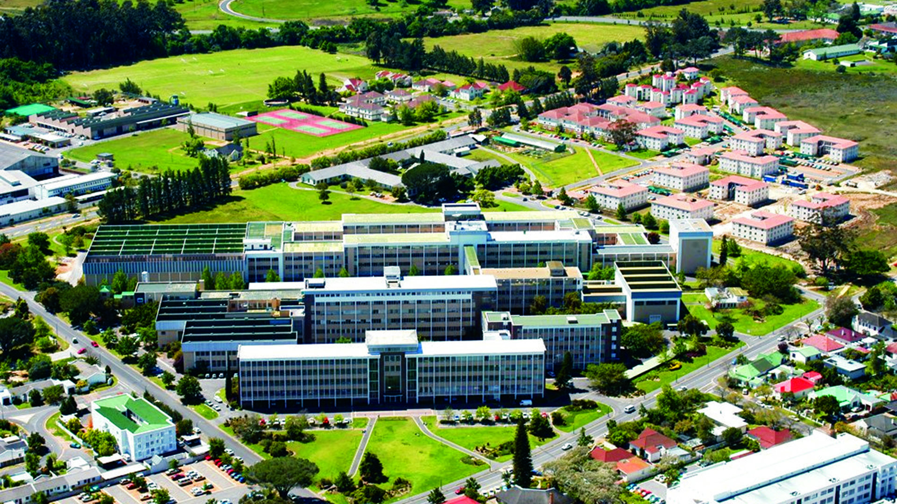
Raspberry Pi Laparoscope: Progress Meeting By Pieter Breytenbach
Photo by Stefan Els
Notes:
Good afternoon, Professors and fellow students. My name is Pieter Breytenbach, and I will share the progress of my project, the Raspberry Pi Laparoscope, with you during this presentation. (14 sec)

Slide 2
Contents
What is a laparoscope?
Objectives and motivation
Current progress
Main design dimensions
Selected concept
Camera modules
Planned steps
Notes:
In this presentation I will be discussing various subjects of importance. Such as what is a laparoscope, what are the objectives and motivation for the project. The current progress of this project. The main design dimensions, selected concept and camera module for the laparoscopes. And lastly the planned steps for the rest of the project. So, let’s get into it.

Slide 3
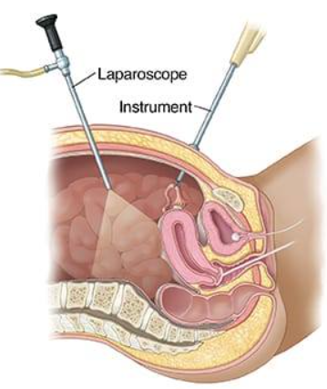
What is a laparoscope?
Notes:
So, what is a laparoscope? Aside from being a tongue twister, the laparoscope is the instrument used during laparoscopy. Laparoscopy is a surgical procedure where small incisions are made on the abdomen of a patient, through which thin rod instruments are inserted into the patient’s body. The laparoscope is a rigid endoscope camera that provides visual feedback to the surgical team by capturing real-time images from within the patient’s body. With the provided visual feedback, the surgical team can perform complex procedures from outside the patient’s body. And this project aims to build a functional low-cost laparoscope (44 sec)

Slide 4
Objectives
Design, program, and build a low-cost laparoscope
Design and build a testing station
Test and evaluate the laparoscope’s performance
Notes:
To achieve the aim of this project, certain objectives need to be met. First and foremost, a low-cost laparoscope should be designed, programmed, and built. The second objective is to determine the laparoscope functionality, by designing and building a testing station. This includes the testing procedures for the station. And the last objective is to test the developed product on the testing station and evaluate the product’s performance. (30 sec)

Slide 5
Motivation
Training simulators
Future robotic system testing
Future university open day displays
Notes:
There are multiple reasons why developing a low-cost laparoscope is beneficial. First and foremost, it can be used to train new surgical staff. Since laparoscopy is a complex procedure to perform, rigorous training is required, with training simulators. This low-cost laparoscope will give trainees the option to train from home if the cost is low enough. Secondly, it can be used for testing future medical robot systems. Future robot prototypes need to be tested, and this could provide a lower financial risk in case the laparoscope is damaged, compared to actual laparoscopes.
And lastly, it can be used in future open days for the university, presented either by the medicine faculty or the biomedical engineering department of the mechanical and mechatronic faculty.

Slide 6
Current Progress
Completed phases:
Literature review
Component review and procurement
Current phase:
Laparoscope design phase
Notes:
So, to give a brief overview of the current progress of this project. The literature review and component review have been completed, as well as the procurement of the camera module for this project, which will be discussed later in the presentation. The current phase is the laparoscope design phase. Currently, the detailed design and system analysis is being conducted.

Slide 7
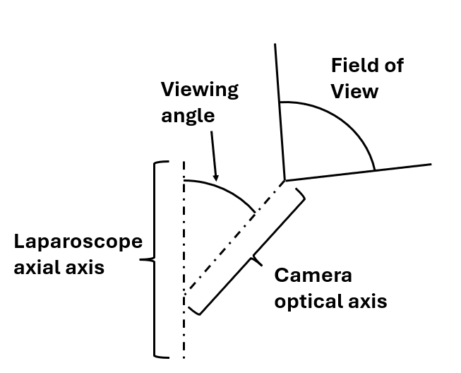
Main design dimensions
Outer diameter: Ø 10 mm
Viewing angle: 30°
Notes:
The main design problem for this laparoscope is these 2 dimensions. The laparoscope should fit within a 10 diameter hole, as well as have a viewing angle of 30 degrees. The viewing angle is the angle between the laparoscope’s axial axis and the camera’s optical axis. As you can see in the picture. It is a common practice for laparoscopes to have a viewing angle of 30 degrees, since this gives surgeons more flexibility in what they can see within the patient’s body.

Slide 8
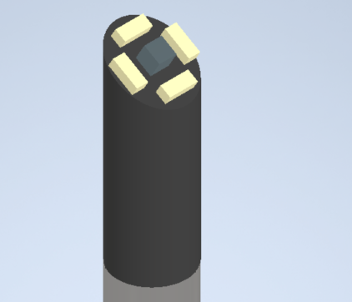
Selected concept
Camera sensor
LED
Camera encasing
Axial rod
Notes:
The selected concept for this project was the tilted camera concept. This design was selected due to its streamlined profile, which will prevent the laparoscope from being turned into a patient organ. It is also the standard industry approach. The main difference is that, instead of a Xenon light source that provides light through a fibre optics cable, an LED light source will be used.

Slide 9
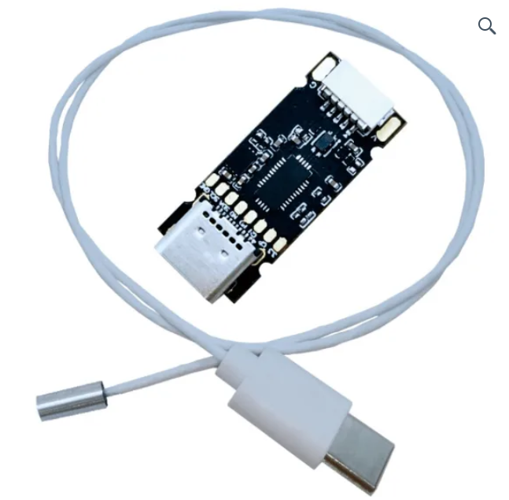
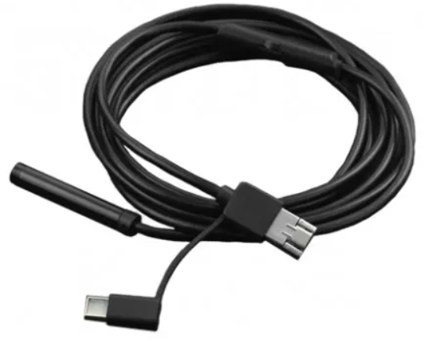
Vision Meta endoscope
DF Robot endoscope
Notes:
As for camera modules that will be used for this project, there are 2 viable options. The first is a product from the company Vision Meta, located in China, that provides a 1 MP endoscope camera, which has an outer diameter of 3 mm and a field of view of 90 degrees. This product, which will be used for this project and has been ordered, is currently in the process of being shipped to the university.
The second product is the DF robot endoscope, which is supplied by Micro Robotics. This camera module has an outer diameter of 8 mm, a field of view of 70 degrees, and an image resolution of 1 MP. This product will only be used if the vision meta product arrives too late for this project. If it were to be used, then the module would need to be modified to achieve a viewing angle of 30 degrees.

Slide 10
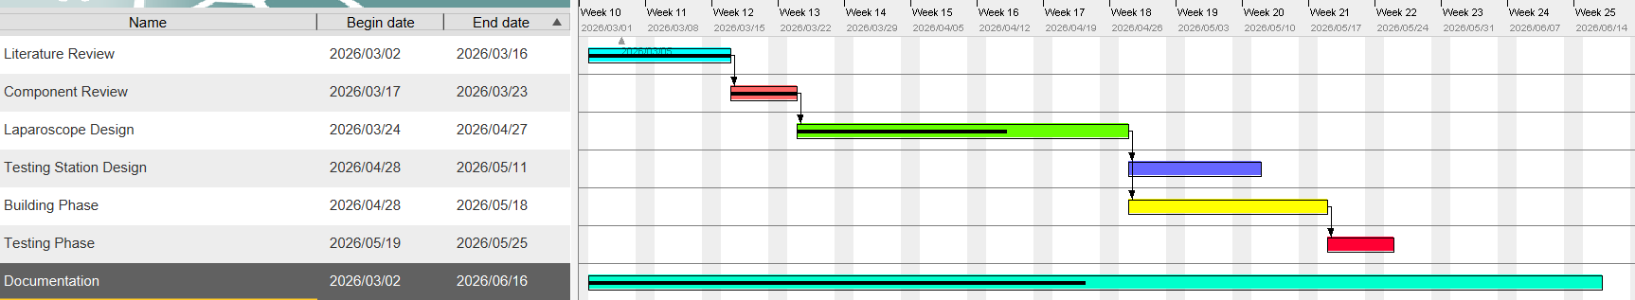
Planned steps
Notes:
And lastly, here is a quick overview of the planned work ahead. First activity that requires to be finished is the laparoscope design phase, which followed by the testing station design phase and building phase over the course of 2 to 3 weeks. After both laparoscope and testing station are built, the laparoscope will be tested , which will be last phase to be completed before the preliminary report hand in on the 25th May. The documentation of the project, is an ongoing phase that will be completed before the final report hand in on the 17th of June.

Slide 11
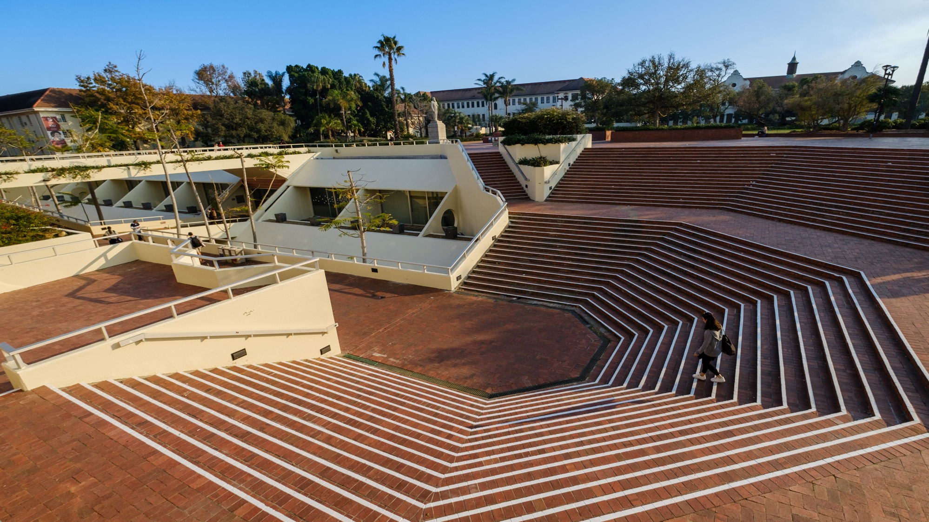
Thank you Enkosi Dankie
Photo by Stefan Els
Notes:
And that is all for my presentation. Is there any questions?

